Slide 1
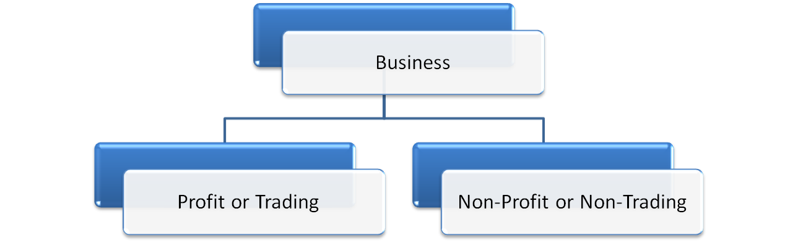
Type of Organisation (Business or Concern).
Sole Proprietorship
Club
Partnership
Hospital
Company
Library

Slide 2
Non-trading concerns
Purpose: To serve the society.
Objectives: To provides services to the members or beneficiaries.
Forms: Clubs, Hospitals, Libraries, Educational Institutions, Charitables, Societies etc.
Accounts:
  Receipts and Payments Account.
  Income and Expenditure Account .
  Balance Sheet:
  Opening Balance Sheet.
  Closing Balance Sheet.

Slide 3
  Receipts and Payments Account.
is a summary of cash book.
is a real a/c.
recorded both revenue and capital transactions.
starts with opening cash and bank balances and also ends with their closing balances.
includes all cash payment and receipts whether related to current, previous and next years.

Slide 4
  2. Income and Expenditure Account .
is a revenue account to find out the surplus and deficit.
is a nominal a/c.
recorded only revenue receipts and payments of the current years.
no opening balance but closing balance is either a Surplus (Income > Expenditure )or Deficit( Expenditure > Income)
Surplus or Deficit is transferred to Capital Fund.
prepared with adjustments.

Slide 5
Important Terms:
Subscriptions. Donations. Life Membership. Entrance Fees. Legacy. Endowment funds. Grants. Sale of Old Assets. | Sale of newspapers. Sale of used old materials. Sale of scraps. Honorarium. Receipts from consumable items. Purchase of consumable items. Purchase of Assets. Special funds.

Slide 6
Calculations:
1. Subscriptions : Rs.
Total subscription received during the year ----
Add: Outstanding of the current year ----
Add: Advance during the previous year ----
Less: Outstanding of the previous year, if included in current year ----
Less: Advance during the current year ----
Amount of subscription to be credited to Income and Expenditure a/c ***

Slide 7
Calculations: contd…
2. Expenses : Rs.
Total expenses paid during the year ----
Add: Outstanding of the current year ----
Add: Advance during the previous year ----
Less: Outstanding of the previous year ----
Less: Advance during the current year ----
Amount of expenses to be debited to Income and Expenditure a/c ***

Slide 8
Calculations: contd…
3. Consumed Items : Rs.
Opening stock of consumed item ----
Add: Purchase during the current year ----
Add: Outstanding of the current year ----
Add: Advance during the previous year ----
Add: Closing creditors of the current year ----
Less: Outstanding of the previous year ----
Less: Advance during the current year ----
Less: Closing stock of consumed item ----
Less: Opening creditors of the current year ----
Amount of consume to be debited to Income and Expenditure a/c ***

Slide 9
Calculations: contd…
4. Depreciation : Rs.
Opening balance of asset ----
Add: Additions during the year ----
Less: Book Value of asset sold ----
Less: Closing balance of asset ----
Deprecation ***

